Slide 1
When Asteroids attack
An Introduction to SEE to Develop Student Interest in HLA
Authors: Dr. Bingyang Wei, Chris Silva, Christine Mounce, Amy Knowles
Presented by: Chris Silva and Christine Mounce

Slide 2
Outline
Introduction
High Level architecture
2016 SEE Experience
2017 SEE Experience
Lessons Learned
Conclusion

Slide 3
Introduction Modeling and simulation
Modeling and Simulation is the representation of the behavior or characteristics of one system through the use of another system.
Used diverse group of computer programs designed under High Level Architecture standard to simulate an environment on the moon.
Interest has increased over recent years
Less expensive, More immersive than real-world experiments
Can be performed faster than real-time
Despite growing interest in Modeling and Simulation, there is a lack of undergraduate level programs focusing on simulation
Programs exist in the graduate levels, few programs exist in the undergraduate level
SEE program is an introduction to distributed simulation that also provides faculty and students with needed elements.
Notes:
Modeling and Simulation (M&S) is the representation of the behavior or characteristics of one system, such as the moon, through the use of another system, which in our case is a diverse group of computer programs designed under the High Level Architecture (HLA) standard. Simulations allow us to view and explore the behavior of a system that may be too expensive or too risky to explore in the real world. Interest in M&S has increased greatly over recent years, in part due to the following reasons:
• Simulations are generally less expensive, and far safer than real-world experiments (ex. supercomputer simulations of nuclear explosions)
• Simulations can be more immersive than attempts at real-world experiments (ex. simulations of surface conditions of nearby planets in preparation for future NASA missions)
• Simulations can be performed faster than real-time (ex. weather simulations)
Although interest in M&S has greatly increased over recent years, there is still a lack of undergraduate level programs focusing on the design and implementation of simulation. As M&S is quickly becoming a multi-billion dollar industry, a highly skilled workforce is required. In order to develop this workforce, modeling and simulation programs need to be developed starting in public school and ranging all the way through graduate level studies. Although programs exist at the masters level and above, few programs exist at the undergraduate level [4]. The SEE program is an excellent introduction to distributed simulation as it provides faculty advisors and students with the needed elements: content, software, tools, systems, mentoring, along with project management support in an attempt to expand M&S undergraduate level education

Slide 4
Introduction Simulation Exploration experience(SEE)
What is SEE?
Led by NASA, SEE joins students, industry, associations, and faculty for a collaborative college-level modeling and simulation learning experience.
Geographically distributed inter-university teams design, develop, test and execute a simulated lunar mission based on a narrative they construct
Who created and contributed to SEE?
The idea of SEE originated with NASA engineer Zack Crues and has been implemented by NASA and SISO Space Community Forum.
Industry Members: FowardSim, Pitch, VSEE, VT MAK, AEgis, MBDA
Professional Associations: SISO, Liophant, SCS, GICSR
Government: NASA
Notes:
Initiated in 2011, the annual Simulation Exploration Experience event, formally known as SISO (Simulation Interoperability Standard Organization) Smackdown, has successfully promoted the awareness of the use of HLA in distributed simulation around the world. During the event, academia, industry and professional associations collaborate to design, develop, test and demonstrate a simulated lunar mission. SEE provides an excellent platform for college students to learn and practice both M&S and software engineering concepts and principles. More importantly, the opportunity of working closely with M&S professionals in industry and associations is an invaluable experience to the students.
SEE originated with NASA engineer Zack Crues and has been implemented annually since 2011 by NASA and the SISO Space Community Forum. It was developed as a way engage students in modeling and simulation, an area of education almost non-existent at the undergraduate level. Because SEE involves geographically distributed inter-university teams, it

Slide 5
Introduction SEE
What does SEE do?
Students work closely with NASA engineers and industry professionals
SEE proves to students the importance of standards to allow the distributed parts of the simulation to work seamlessly
SEE program allows students to learn HLA and simulation in an interesting, fail-free environment with expert and peer support.
Can assess their own interest for a career in simulation
Notes:
proves to the participants that interoperability and standards matter in order to allow distributed parts of the simulation to work seamlessly. This program allows students to learn HLA in a fail-free environment with expert and peer support, to learn employer expectations first-hand, as well as allow them to assess their interest and aptitude for a career in M&S

Slide 6
High Level Architecture (HLA)
Enables several simulation systems to work together seamlessly
IEEE standard 1516-2010
Does not rely on all simulations using the same programming language
Each simulation system can work together or by itself
It used in some Department of Defense simulations

Slide 7
HLA Terminology
Runtime Infrastructure (RTI) – A piece of software that provides the HLA services.
Federate – A system that connects to the RTI and can model any number of objects in a simulation
Federation Object Model (FOM) – A file that contains a description of the data exchange in a Federation
Federation – All of the federates along with the RTI and the FOM that they use
Federation Execution – An instance of the federation

Slide 8
HLA: Connecting
Had a choice of using Pitch Technology’s pRTI or VT Mäk’s Mäk RTI for the RTI software.
Chose Pitch because Mäk had problems with Java
Local RTI Component (LRC)
A local library installed on each computer with a federate. “dll” file for C++ federates, “jar” for java.
Central RTI Component (CRC)
An application that coordinates the federation execution and keeps track of the joined federates.
Must be started before any federate can join a federation

Slide 9
HLA: Services
To use these services a federate will make calls to the RTI and receive callbacks from the RTI, which makes a two-way communication
The data exchanged between federates are object attributes and interactions.
Publish and Subscribe
Update and Reflect Attribute Values
Send and Receive Interactions
Should note, federates don’t talk to each other directly. The RTI gives each federate the data it wants through the above functions.
Notes:
These services enable federates to exchange data according to the FOM using a pub/sub scheme
HLA has a lot of services, and students have to learn these concepts and how to implement them.

Slide 10
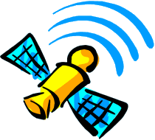
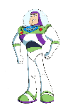

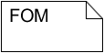
HLA: Pub/Sub and Update/Reflect
Our federate is a constellation of communications satellites
Here are some of our publish and subscribe
Publish
Entity Name
Parent reference frame
Position
RX message
UpdateAttributeValues
Subscribe
Entity name
Parent reference frame
Position
TX message
ReflectAttributeValues
o₁
o₄
o₂
o₅
Time management
Visualization
Logging
o₇
o₈
o₃
o₆
f₁
f₂
f₃
f₄
Runtime Infrastructure (RTI)
Notes:
The RTI keeps track of which federates subscribe to a certain type of data, which means that the federates want to receive that type of data. It also keeps track of which federates publish each type of object, attribute, or interaction, which means that they are able to send that type of data. Finally the RTI acts like a switchboard and delivers data from publishers to subscribers.
Once a federate has published, how does it notify others to receive updates?
A federate does not have to worry about how to deliver or whether or not a federate receives or when it receives, this is taken care of by RTI.
This slide tells you how to work with attribute values for object instances. This includes both sending and receiving values.
The UpdateAttributeValues is used to send an update for a set of attributes for a specific object instance
Updates are typically sent when the value has changed or when another federate needs and update.
Your federate receives the ReflectAttributeValues with updated attribute values for attributes that is subscribes to
This callback is invoked on your federate when another federate requests the most recent value of an attribute of one of your object instances. This request is performed automatically by the RTI on behalf of a federate that discovers a new object instance

Slide 11
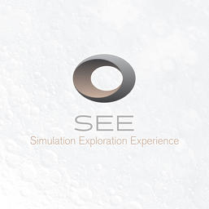

2016 SEE Experience: Team mwsu
4 computer science students, one graduate and three undergraduates
Sponsoring professor and local HLA expert, Dr. Bingyang Wei
Began meeting in Fall 2015 to prepare for SEE 2016 workshop at the 2016 SCS Spring Simulation Multi-Conference (SpringSim ’16) that took place in Liverpool, England.
Experience allowed students to implement knowledge learned in our computer science courses: software engineering, contemporary programming, and discrete system simulation
Notes:
The Simulation Exploration Experience, hosted by NASA is an exciting and immersive experience in modeling and distributed simulation. The 2016 MWSU Sim team consisted of four computer science students, one graduate and three undergraduates, and our sponsoring professor and local HLA expert, Dr. Bingyang Wei. We began meeting formally late in the Fall 2015 semester in preparation for our participation in the SEE 2016 workshop at the 2016 SCS Spring Simulation Multi-Conference (SpringSim ’16) that took place in Liverpool, England. This experience allowed us to implement knowledge learned in multiple courses, such as software engineering, discrete system simulation, and contemporary programming. Our ﬁrst step in preparing ourselves for writing our own federate was to download the HLA tutorial available on the Pitch website [1]. Once we fully understood the HLA model, we were able to access and complete numerous tutorials on creating federates available to participating SEE team members in the SEE Assembla repository. The following subsections describe the MWSU Sim team satellite federate, and the team’s experiences interacting with industry professions, NASA engineers, and college students from around the world.
A. Satellite Constellation & Lunar Visualization Module The Satellite Constellation & Lunar Visualization module ﬁrst propagates and then renders satellite constellations. The Systems Tool Kit’ (STK) numerical propagator is invoked to generate the orbits of different satellites. The constellation is achieved by STK’s High Precision Orbit Propagator (HPOP) which is a part of the Orbit Propagation Library (OPL). By numerically integrating the various forces affecting satellites, HPOP brings high ﬁdelity orbit propagation into our communication satellites. When the whole federation is running on Pitch RTI, a 6-satellite constellation is designed over Aitken Basin to maximize the time each satellite is in view of the surface entities as shown in Figure 2. The architecture of the Satellite Constellation & Lunar Visualization module is shown in, Figure 3, a UML class diagram.

Slide 12
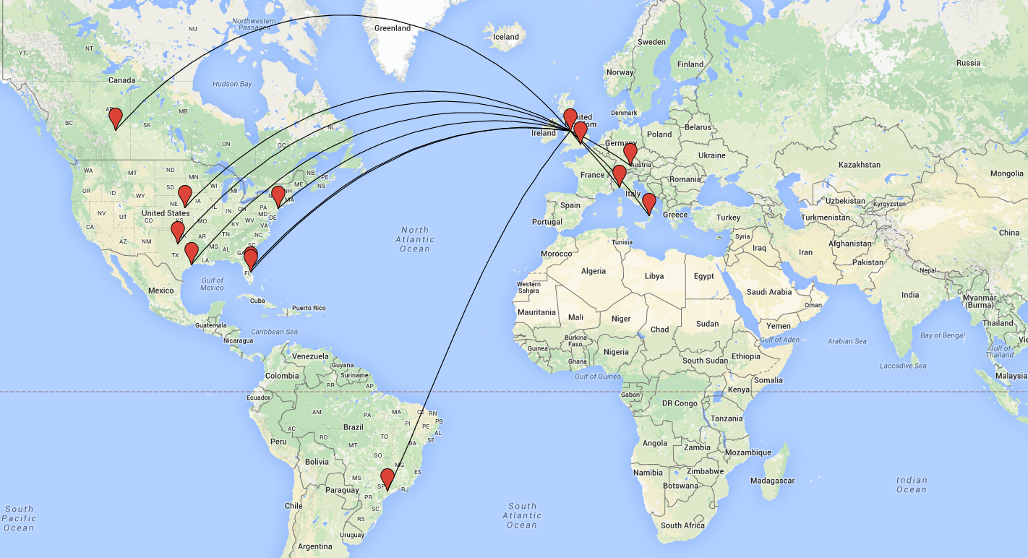
2016 SEE Experience
LAUNCH DAY:
Date: March 23, 2016
Where: Liverpool, England
When: 4pm UTC (11am CST)
VSEE Video Chat
19 Federates ran by teams from
12 Universities in 7 countries
Notes:
Emphasize geographic separation of teams.
Using VPN, a network to run simulation
All teams, and countries

Slide 13
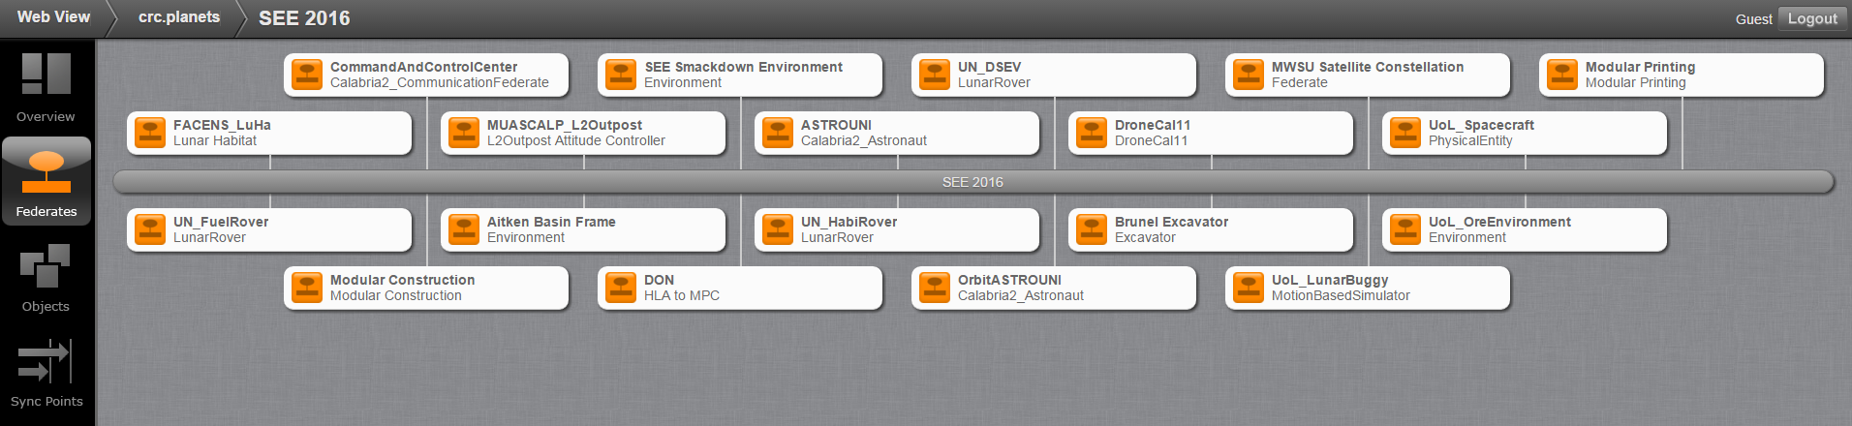
2016 SEE Experience
Notes:
POINT TO PUR FEDERATE
Lollipop diagram
Mention some universities

Slide 14
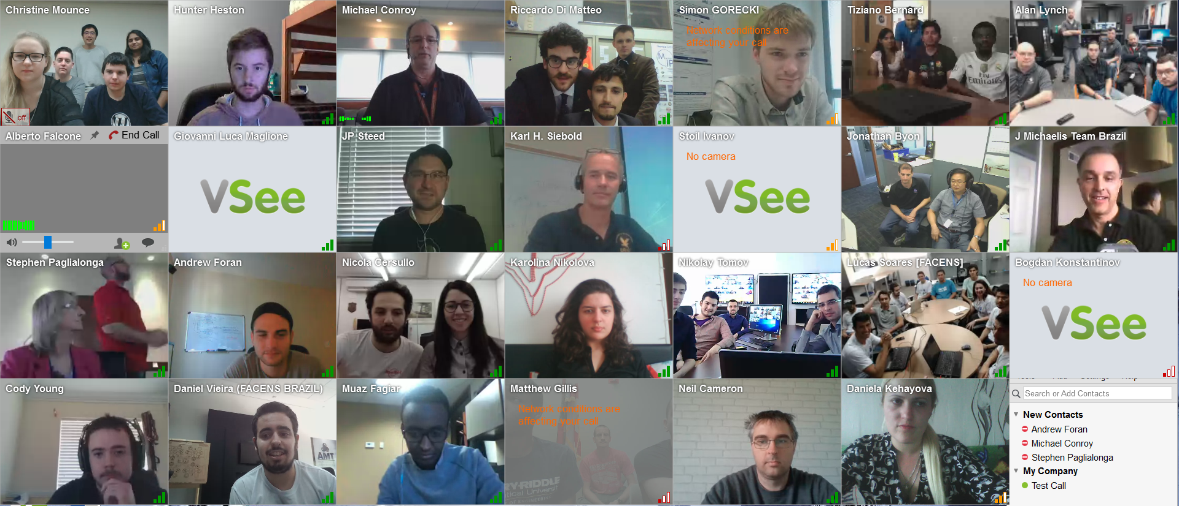
2017 SEE Experience
Launch Day:
Date: April 5, 2017
When: 9am CST
VSEE Video Chat

Slide 15
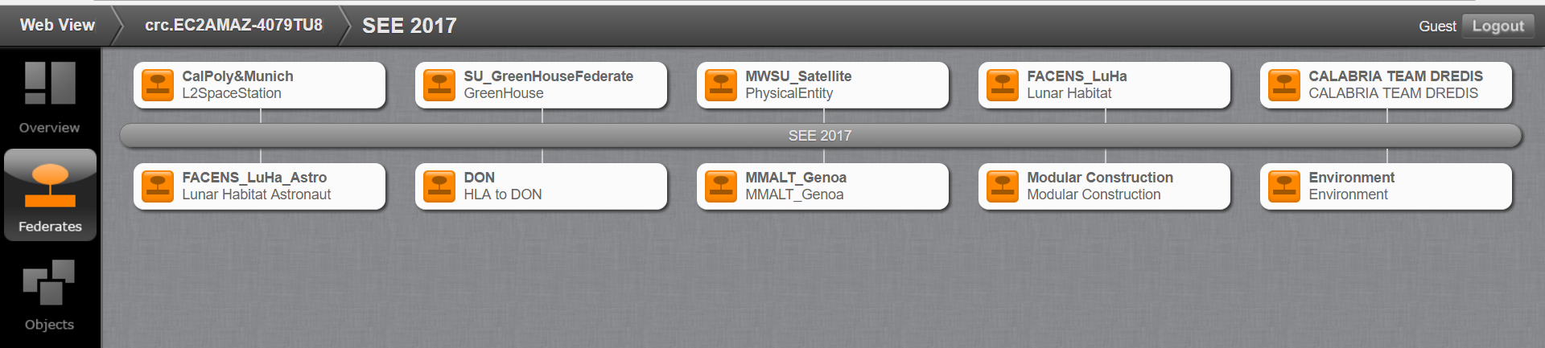
2017 SEE experience

Slide 16
Lessons Learned
Email and talk to people from other teams and NASA
Importance of communication
Start to develop federate early
Recommended starting in Sept.
HLA has a steep learning curve
Recruit students early

Slide 17
Conclusion
All the teams participating in SEE demonstrated the capabilities that modeling and simulation can bring to solve difficult problems
Distributed simulations is an interesting and in-demand field
MWSU Sim Team enjoyed participating these past 2 years
Visit www.exploresim.com/team to start your own team

Slide 18
references
HLA Tutorial from Pitch Technologies
Time Management in High Level Architecture by Richard M. Fujimoto, Gearogia Institute of Technology
SEE HLA Starter Kit from University of Calabria

